Slide 1
Big Data Analytics course CSDA1000SUMA18 Group 1, Final Project
Airport Gate Assignment Optimization Presentation
Viviane Adohouannon
Kate Alexander
Juan Arangote
Diana Azbel
Igor Baranov
York University School of Continuous Studies

Slide 2
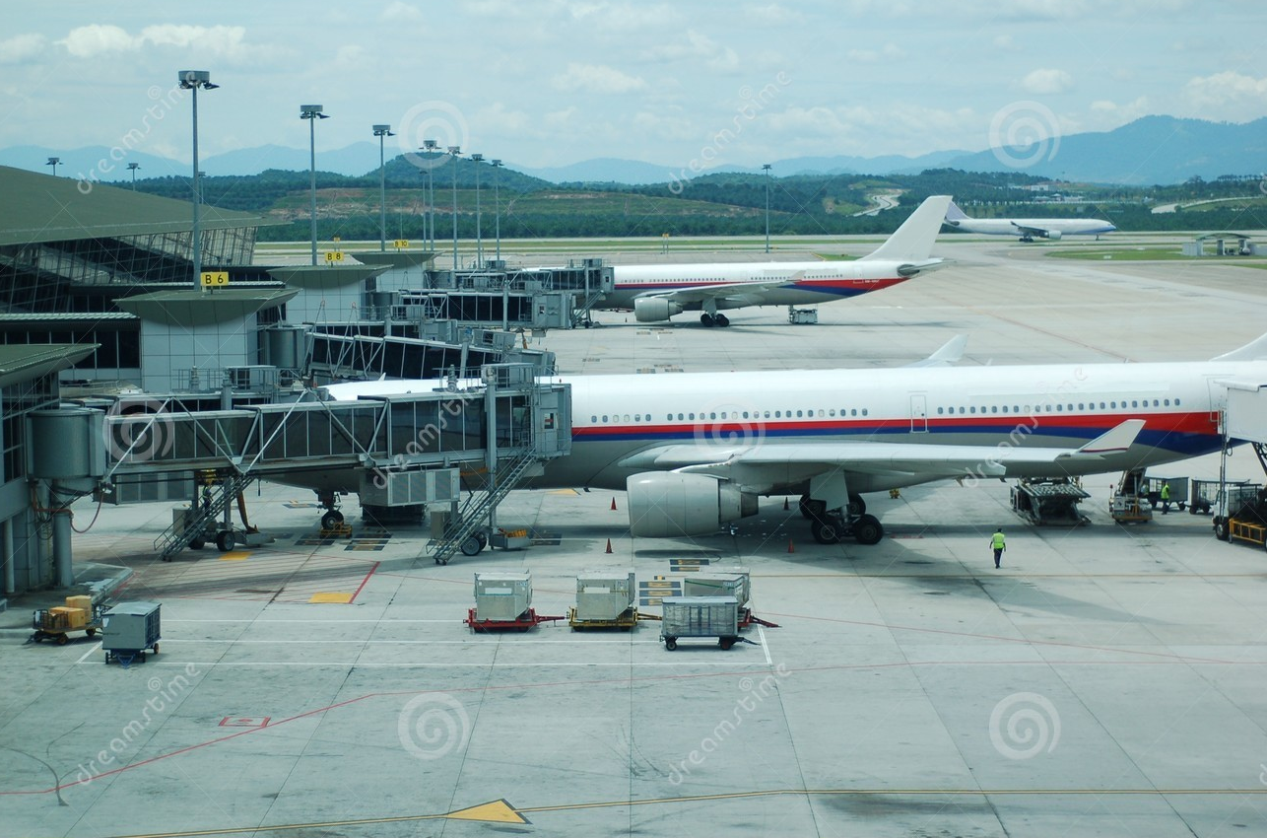
Our Research – Mundane part of modern life

Slide 3
Airports consists of complex systems
Regulatory
Airport Operator
Airlines
Passengers / Guests
Environment
Baggage
Climate Control
Check-in
Fire and Emergency
Safety
Retail
Finance & Accounts
Treasury
Gates
Security
Land Use
Facilities
HR

Slide 4
Breakdown results in bad experience, costs and, possibly, damaged goodwill or brand
Regulatory
Airport Operator
Airlines
Passengers / Guests
Environment
Baggage
Climate Control
Check-in
Fire and Emergency
Safety
Retail
Finance & Accounts
Treasury
Gates
Security
Land Use
Facilities
HR

Slide 5
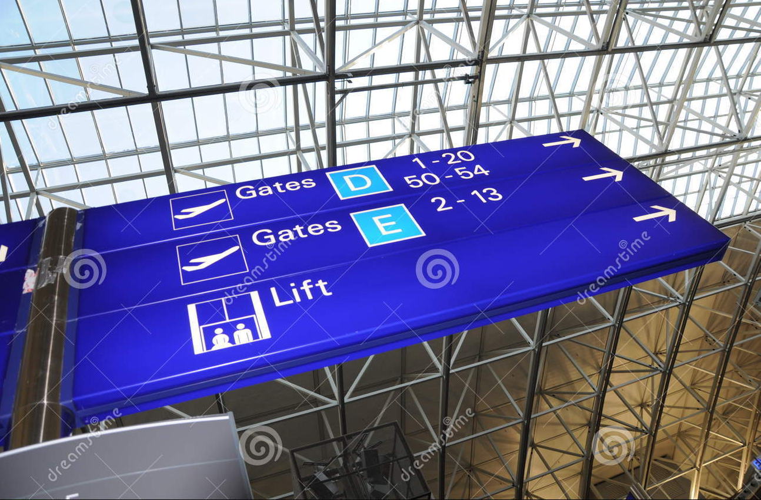
Gates management is the hand off between airlines and airports…

Slide 6
…focus on sub-optimal performance – breaks in the systems
Airline Performance
Delays
Cancellations

Slide 7
How does sub-optimal gate management affect passengers and airports
Baseline
Paint the Future
Action Plan
Historical Performance
Forecast
Recommendation
Linear Programming

Slide 8
Data overview, insight's - Viviane
Information from 22 years has been retrieved from airlines transportation database. These datasets are from 1987 to 2008 and are relative to United State airlines performance, for the data description. As an example, for the year 2008, SFO airport has 140.587 flights from 15 different carriers. The top 4 most important carriers are United Airlines Inc with 31% of total traffic followed by SkyWest Airlines Inc. (28%), Southwest Airlines Co. (9%) and American Airlines Inc. (9%). Number of flights per carrier, delays trend and cancellation analysis at San Francisco International Airport (SFO) presented here (see Tables 1, 2,3 and 4). For that analysis the following datasets were analyzed:
Airline on-time performance reports (“Airline on-time performance reports,” n.d.);
1987-2008 US Flights statistics (“Data elements,” n.d.);
SFO Gate and Stand Assignment Information (“Sfo gate and stand assignment information - data. Gov,” n.d.);
2015 US Flights statistics (“2015 flight delays and cancellations kaggle,” n.d.);
Aircraft registry (“Aircraft registry – releasable aircraft database download,” n.d.)..
Table 2: Delay trend IN/OUT in minute for the top (United Airlines Inc ) carrier at SFO
Table 1: Number of flights per carrier at San Francisco International Airport (SFO)
United Air Lines Inc. | Delay IN | Delay OUT
Jan-08 | 94,084 | 102,706
Feb-08 | 50,629 | 56,384
Mar-08 | 23,240 | 38,367
Apr-08 | 22,525 | 36,477
May-08 | 34,390 | 44,159
Jun-08 | 65,529 | 79,900
Jul-08 | 51,381 | 64,791
Aug-08 | 44,212 | 58,489
Sep-08 | 18,530 | 23,058
Oct-08 | 746 | 19,209
Nov-08 | 7,366 | 26,756
Dec-08 | 19,252 | 52,767
Total | 431,884 | 603,063
Month | AA | AS | B6 | CO | DL | F9 | FL | HA | MQ | NW | OO | UA | US | WN | XE
Jan-08 | 976 | 426 | 155 | 373 | 374 | 129 | 38 | 31 | 147 | 282 | 3,454 | 3,656 | 591 | 793 | 148
Feb-08 | 896 | 401 | 145 | 339 | 346 | 126 | 29 | 29 | 137 | 257 | 3,230 | 3,455 | 548 | 754 | 123
Mar-08 | 956 | 429 | 155 | 375 | 366 | 142 | 31 | 31 | 145 | 274 | 3,452 | 3,719 | 599 | 992 | 145
Apr-08 | 1,014 | 416 | 150 | 365 | 356 | 138 | 52 | 30 | 142 | 292 | 3,102 | 3,746 | 574 | 1,022 | 140
May-08 | 1,067 | 418 | 208 | 414 | 366 | 150 | 117 | 31 | 146 | 369 | 3,144 | 3,840 | 609 | 1,093 | 142
Jun-08 | 1,037 | 407 | 206 | 448 | 419 | 175 | 149 | 30 | 141 | 411 | 3,140 | 3,896 | 592 | 1,085 | 167
Jul-08 | 1,062 | 474 | 187 | 483 | 444 | 182 | 184 | 31 | 147 | 433 | 3,199 | 4,066 | 668 | 1,108 | 177
Aug-08 | 1,065 | 461 | 168 | 482 | 441 | 170 | 171 | 31 | 145 | 378 | 3,259 | 3,973 | 656 | 1,094 | 157
Sep-08 | 1,005 | 406 | 122 | 390 | 362 | 118 | 61 | 30 | 146 | 292 | 3,297 | 3,370 | 581 | 1,142 | 4
Oct-08 | 1,038 | 422 | 123 | 396 | 368 | 120 | 53 | 31 | 151 | 302 | 3,402 | 3,478 | 591 | 1,183
Nov-08 | 925 | 397 | 149 | 348 | 354 | 115 | 31 | 30 | 144 | 263 | 3,134 | 3,183 | 545 | 1,130
Dec-08 | 967 | 405 | 155 | 388 | 379 | 121 | 35 | 31 | 151 | 274 | 3,214 | 3,354 | 558 | 1,172
Total | 12,008 | 5,062 | 1,923 | 4,801 | 4,575 | 1,686 | 951 | 366 | 1,742 | 3,827 | 39,027 | 43,736 | 7,112 | 12,568 | 1,203
 | 9% | 4% | 1% | 3% | 3% | 1% | 1% | 0% | 1% | 3% | 28% | 31% | 5% | 9% | 1%

Slide 9
Data overview, insight's - Viviane
From the cancellation trend 3% of total American Airlines Inc. flights have been cancelled in 2008. are United Airlines Inc and SkyWest Airlines Inc. remain the top carriers whose have been mostly cancelled. These are the top 2 airlines at SFO with the most significant flights and those cancellation provide a very bad experience to their travelers. It also have a negative impact on the entire airport performance and it is critical to address it.
Table 3: Delay trend IN/OUT in minute for SkyWest Airlines Inc. and American Airlines Inc. at SFO
Table 4: Total Cancellations
Skywest Airlines Inc. | Delay IN | Delay OUT
Jan-08 | 106,481 | 103,481
Feb-08 | 63,981 | 62,554
Mar-08 | 19,700 | 22,443
Apr-08 | 8,118 | 11,904
May-08 | 30,016 | 30,286
Jun-08 | 48,004 | 53,838
Jul-08 | 49,629 | 54,604
Aug-08 | 38,219 | 44,238
Sep-08 | 31,184 | 32,866
Oct-08 | 23,892 | 26,560
Nov-08 | 39,507 | 42,998
Dec-08 | 75,341 | 77,339
Total | 534,072 | 563,111
American Airlines Inc. | Delay IN | Delay OUT
Jan-08 | 30,246 | 32,806
Feb-08 | 19,885 | 19,406
Mar-08 | 12,059 | 15,173
Apr-08 | 10,863 | 15,392
May-08 | 16,239 | 18,202
Jun-08 | 25,219 | 29,041
Jul-08 | 19,609 | 20,275
Aug-08 | 12,081 | 13,967
Sep-08 | 8,865 | 10,137
Oct-08 | 5,941 | 10,102
Nov-08 | 5,398 | 8,078
Dec-08 | 8,426 | 14,567
Total | 174,831 | 207,146
Month | AA | OO | UA | WN | Grand Total
Jan-08 | 50 | 329 | 190 | 44 | 613
Feb-08 | 37 | 100 | 75 | 18 | 230
Mar-08 | 42 | 42 | 79 | 18 | 181
Apr-08 | 67 | 9 | 54 | 22 | 152
May-08 | 26 | 24 | 75 | 9 | 134
Jun-08 | 20 | 67 | 81 | 24 | 192
Jul-08 | 22 | 63 | 116 | 26 | 227
Aug-08 | 23 | 17 | 68 | 16 | 124
Sep-08 | 13 | 30 | 28 | 16 | 87
Oct-08 | 9 | 35 | 19 | 17 | 80
Nov-08 | 10 | 62 | 27 | 37 | 136
Dec-08 | 16 | 125 | 60 | 44 | 245
Total | 335 | 903 | 872 | 291 | 2,401

Slide 10

Airlines performance analysis – Diana & Kate
Dataset: 2015 Flight Delays and Cancellations
From: United States of America, Department of Transportation
URL: https://www.kaggle.com/usdot/flight-delays/data
airlines.csv
airports.csv
flights.csv
Dataset: Aircraft Registry
From: United States of America, Federal Aviation Registry
URL: https://www.faa.gov/licenses_certificates/aircraft_certification/aircraft_registry/
MASTER.txt
ACFTREF.txt
Research focus: San Francisco International Airport (SFO)

Slide 11
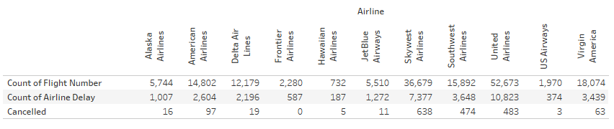
Airlines performance analysis
Baseline:
Total count of Airline Delay: 33,514
Total number of Cancelled flights: 1,809
Total number of flights: 166,535
Estimated number of Passengers: 366,043,930

Slide 12
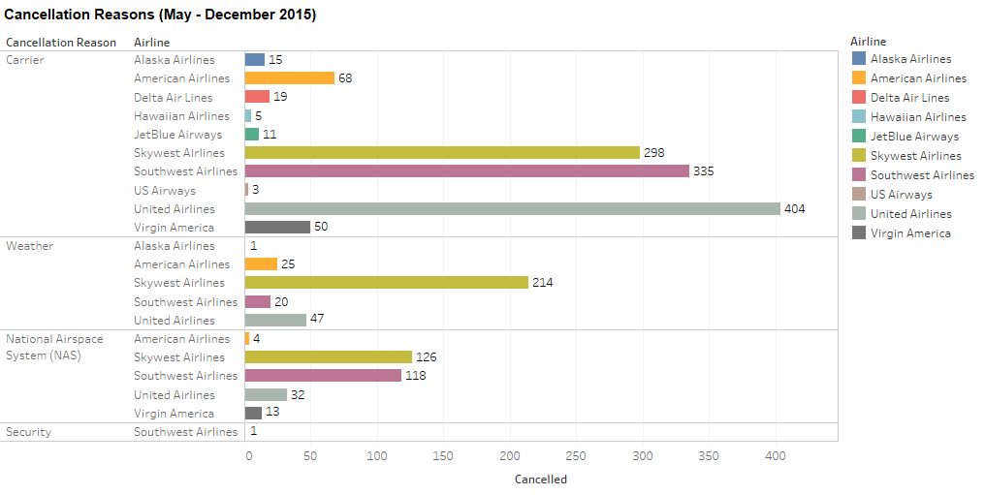
Airlines performance analysis
Sum of Cancellation Reasons vs. Airline – May through December 2015
Sum of Cancelled for each Airline broken down by Airport Origin vs. Cancellation Reason.
Colour shows details about the Airline.
This view is filtered on Cancellation Reason.

Slide 13
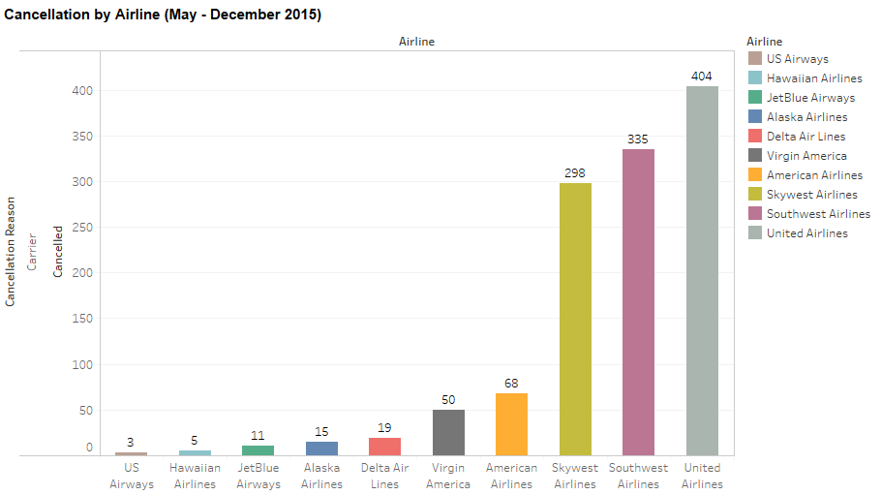
Airlines performance analysis
Sum of all cancellations by Airlines: 1,208 flights (May through December 2015)

Slide 14
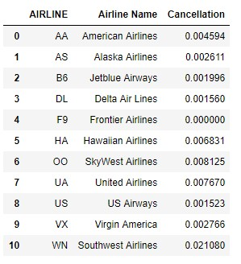
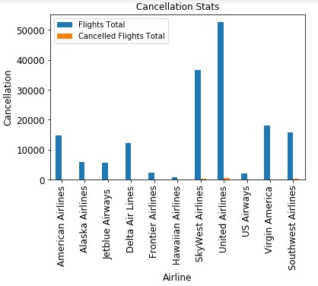
Percentage of cancellation per Airline

Slide 15
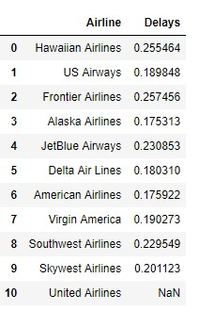
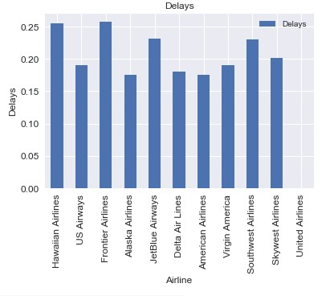
Airlines performance analysis
Percentage of delay per Airline

Slide 16
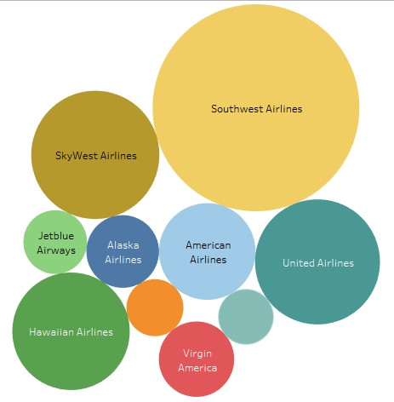
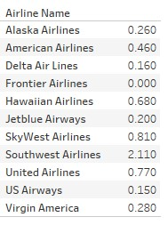
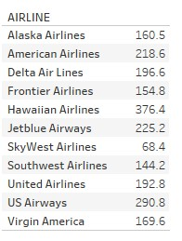
Airlines performance analysis
The estimated number of passengers per Airline
Estimate number of passengers affected by Cancellations per Airline

Slide 17
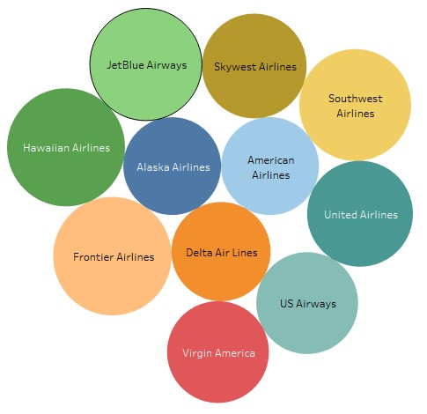
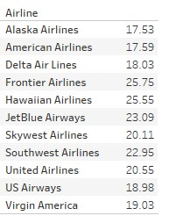
Airlines performance analysis
Estimate number of passengers affected by delay per Airline

Slide 18
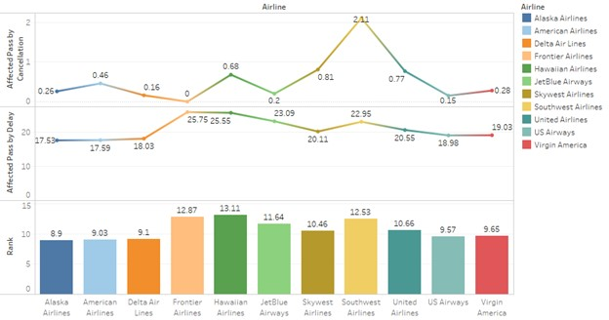
Airlines performance analysis
Results: Performance of the Airlines:

Slide 19
Airlines performance analysis
Historical data and linear progressing, the estimated future delays and cancellations in the next 5, 10, 20 years by airline
For the best airline only

Slide 20
Model development - Igor
The model base on optimal resource optimization using Linear Programming was chosen
The target function: MAX number of people served by the terminal in the target week
Constrains applied (target week):
Min number of flights granted to each airline
Max number of flights granted to each airline
Min number of flights assigned to each gate
Max number of flights assigned to each gate

Slide 21

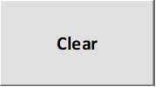
SFO Gates - Weekly Allocation – input 1
 |  |  |  |  |  |  |  |  |  | False False False False
Number of people served: | 121701
Number of people served in 2015: | 121701
Number of people served increment: | 0%
Number of people delayed: | 815
Gate usage [times a day] (9): | 9
Gate usage increase: | 1
Airline gate allowance increase: | 1
Suggested Gate Allocations:
Airlines |  | Gates |  |  |  |  |  |  |  |  |  |  |  | Flights Granted | Min Flights to assign | Max Flights to assign
Name | Code | 1 | 2 | 3 | 4 | 5 | 6 | 7 | 8 | 9 | 10 | 11 | 12
American Airlines | AA | 0 | 0 | 0 | 4 | 0 | 63 | 0 | 0 | 0 | 0 | 0 | 0 | 67 | 0 | 67
Alaska Airlines | AS | 0 | 0 | 0 | 0 | 0 | 0 | 0 | 0 | 0 | 0 | 26 | 0 | 26 | 0 | 26
Jetblue Airways | B6 | 0 | 0 | 0 | 0 | 0 | 0 | 0 | 0 | 0 | 0 | 25 | 0 | 25 | 0 | 25
Delta Air Lines | DL | 0 | 0 | 0 | 0 | 0 | 0 | 49 | 0 | 4 | 0 | 2 | 0 | 55 | 0 | 55
Frontier Airlines | F9 | 0 | 0 | 0 | 0 | 0 | 0 | 10 | 0 | 0 | 0 | 0 | 0 | 10 | 0 | 10
Hawaiian Airlines | HA | 0 | 0 | 0 | 0 | 0 | 0 | 3 | 0 | 0 | 0 | 0 | 0 | 3 | 0 | 3
SkyWest Airlines | OO | 0 | 0 | 0 | 44 | 0 | 0 | 0 | 63 | 59 | 0 | 0 | 0 | 166 | 0 | 166
United Airlines | UA | 0 | 63 | 0 | 15 | 35 | 0 | 0 | 0 | 0 | 63 | 0 | 63 | 239 | 0 | 239
US Airways | US | 0 | 0 | 0 | 0 | 0 | 0 | 0 | 0 | 0 | 0 | 9 | 0 | 9 | 0 | 9
Virgin America | VX | 0 | 0 | 54 | 0 | 28 | 0 | 0 | 0 | 0 | 0 | 0 | 0 | 82 | 0 | 82
Southwest Airlines | WN | 63 | 0 | 9 | 0 | 0 | 0 | 0 | 0 | 0 | 0 | 0 | 0 | 72 | 0 | 72
Flights assigned actual |  | 63 | 63 | 63 | 63 | 63 | 63 | 63 | 63 | 63 | 63 | 62 | 63
Min flights per gate allowed |  | 0 | 0 | 0 | 0 | 0 | 0 | 0 | 0 | 0 | 0 | 0 | 0
Max flights per gate allowed |  | 63 | 63 | 63 | 63 | 63 | 63 | 63 | 63 | 63 | 63 | 63 | 63

Slide 22
SFO Gates - Weekly Allocation – input 2
Airlines Historical Behavior SFO (May-Nov):
Airlines |  | Reliability |  | Avg People on a flight |  | Total Flights |  | Flights weekly T1 |  | Total People |  | People Delayed
Name | Code
American Airlines | AA | 0.9954 |  | 218.58 |  | 14802 |  | 67 |  | 3220562 |  | 14795
Alaska Airlines | AS | 0.9974 |  | 160.47 |  | 5744 |  | 26 |  | 919360 |  | 2400
Jetblue Airways | B6 | 0.9980 |  | 225.16 |  | 5510 |  | 25 |  | 1238179 |  | 2471
Delta Air Lines | DL | 0.9984 |  | 196.58 |  | 12179 |  | 55 |  | 2390472 |  | 3729
Frontier Airlines | F9 | 1.0000 |  | 154.83 |  | 2280 |  | 10 |  | 353002 |  | 0
Hawaiian Airlines | HA | 0.9922 |  | 376.45 |  | 732 |  | 3 |  | 273402 |  | 2141
SkyWest Airlines | OO | 0.9919 |  | 68.41 |  | 36679 |  | 166 |  | 2488916 |  | 20222
United Airlines | UA | 0.9923 |  | 192.85 |  | 52673 |  | 239 |  | 10079832 |  | 77312
US Airways | US | 0.9985 |  | 290.83 |  | 1970 |  | 9 |  | 572057 |  | 871
Virgin America | VX | 0.9972 |  | 169.60 |  | 18074 |  | 82 |  | 3056779 |  | 8559
Southwest Airlines | WN | 0.9789 |  | 144.15 |  | 15892 |  | 72 |  | 2242581 |  | 47274

Slide 23
SFO Gates - Weekly Allocation – input 3
Gate Preferences:
Airlines |  | Gates
Name | Code | A1 | A2 | A3 | A4 | A5 | A6 | A7 | A8 | A9 | A10 | A11 | A12
American Airlines | AA | 1 | 1 | 1 | 1 | 1 | 1 | 1 | 1 | 1 | 1 | 1 | 1
Alaska Airlines | AS | 1 | 1 | 1 | 1 | 1 | 1 | 1 | 1 | 1 | 1 | 1 | 1
Jetblue Airways | B6 | 1 | 1 | 1 | 1 | 1 | 1 | 1 | 1 | 1 | 1 | 1 | 1
Delta Air Lines | DL | 1 | 1 | 1 | 1 | 1 | 1 | 1 | 1 | 1 | 1 | 1 | 1
Frontier Airlines | F9 | 1 | 1 | 1 | 1 | 1 | 1 | 1 | 1 | 1 | 1 | 1 | 1
Hawaiian Airlines | HA | 1 | 1 | 1 | 1 | 1 | 1 | 1 | 1 | 1 | 1 | 1 | 1
SkyWest Airlines | OO | 1 | 1 | 1 | 1 | 1 | 1 | 1 | 1 | 1 | 1 | 1 | 1
United Airlines | UA | 1 | 1 | 1 | 1 | 1 | 1 | 1 | 1 | 1 | 1 | 1 | 1
US Airways | US | 1 | 1 | 1 | 1 | 1 | 1 | 1 | 1 | 1 | 1 | 1 | 1
Virgin America | VX | 1 | 1 | 1 | 1 | 1 | 1 | 1 | 1 | 1 | 1 | 1 | 1
Southwest Airlines | WN | 1 | 1 | 1 | 1 | 1 | 1 | 1 | 1 | 1 | 1 | 1 | 1
Relaxed:
Gate Preferences:
Airlines |  | Gates
Name | Code | A1 | A2 | A3 | A4 | A5 | A6 | A7 | A8 | A9 | A10 | A11 | A12
American Airlines | AA | 1 | 1 | 0 | 0 | 0 | 0 | 0 | 0 | 0 | 0 | 0 | 0
Alaska Airlines | AS | 0 | 1 | 1 | 0 | 0 | 0 | 0 | 0 | 0 | 0 | 0 | 0
Jetblue Airways | B6 | 0 | 0 | 1 | 1 | 0 | 0 | 0 | 0 | 0 | 0 | 0 | 0
Delta Air Lines | DL | 0 | 0 | 0 | 1 | 1 | 0 | 0 | 0 | 0 | 0 | 0 | 0
Frontier Airlines | F9 | 0 | 0 | 0 | 0 | 1 | 1 | 0 | 0 | 0 | 0 | 0 | 0
Hawaiian Airlines | HA | 0 | 0 | 0 | 0 | 0 | 1 | 1 | 0 | 0 | 0 | 0 | 0
SkyWest Airlines | OO | 0 | 0 | 0 | 0 | 0 | 0 | 1 | 1 | 0 | 0 | 0 | 0
United Airlines | UA | 0 | 0 | 0 | 0 | 0 | 0 | 0 | 1 | 1 | 0 | 0 | 0
US Airways | US | 0 | 0 | 0 | 0 | 0 | 0 | 0 | 0 | 1 | 1 | 0 | 0
Virgin America | VX | 0 | 0 | 0 | 0 | 0 | 0 | 0 | 0 | 0 | 1 | 1 | 0
Southwest Airlines | WN | 0 | 0 | 0 | 0 | 0 | 0 | 0 | 0 | 0 | 0 | 1 | 1
Restricted:

Slide 24
Weekly Allocation: allow more flights
Number of people served: | 139364
Number of people served in 2015: | 121701
Number of people served increment: | 15%
Number of people delayed: | 915 | Increase: |  | 12%
Gate usage [times a day] (9): | 9
Gate usage increase: | 1
Airline gate allowance increase: | 1.25
Suggested Gate Allocations:
Airlines |  | Gates |  |  |  |  |  |  |  |  |  |  |  | Flights Granted | Min Flights to assign | Max Flights to assign
Name | Code | A1 | A2 | A3 | A4 | A5 | A6 | A7 | A8 | A9 | A10 | A11 | A12
American Airlines | AA | 0 | 0 | 0 | 21 | 0 | 63 | 0 | 0 | 0 | 0 | 0 | 0 | 84 | 0 | 84
Alaska Airlines | AS | 0 | 0 | 0 | 0 | 0 | 0 | 0 | 0 | 0 | 0 | 33 | 0 | 33 | 0 | 33
Jetblue Airways | B6 | 0 | 0 | 0 | 0 | 0 | 0 | 0 | 0 | 12 | 0 | 19 | 0 | 31 | 0 | 31
Delta Air Lines | DL | 0 | 0 | 0 | 0 | 0 | 0 | 0 | 18 | 51 | 0 | 0 | 0 | 69 | 0 | 69
Frontier Airlines | F9 | 0 | 0 | 0 | 0 | 0 | 0 | 0 | 13 | 0 | 0 | 0 | 0 | 13 | 0 | 13
Hawaiian Airlines | HA | 0 | 0 | 0 | 0 | 0 | 0 | 0 | 4 | 0 | 0 | 0 | 0 | 4 | 0 | 4
SkyWest Airlines | OO | 0 | 0 | 0 | 0 | 0 | 0 | 0 | 20 | 0 | 0 | 0 | 0 | 20 | 0 | 208
United Airlines | UA | 0 | 63 | 0 | 42 | 0 | 0 | 63 | 8 | 0 | 59 | 0 | 63 | 299 | 0 | 299
US Airways | US | 0 | 0 | 0 | 0 | 0 | 0 | 0 | 0 | 0 | 0 | 11 | 0 | 11 | 0 | 11
Virgin America | VX | 0 | 0 | 36 | 0 | 63 | 0 | 0 | 0 | 0 | 4 | 0 | 0 | 102 | 0 | 102
Southwest Airlines | WN | 63 | 0 | 27 | 0 | 0 | 0 | 0 | 0 | 0 | 0 | 0 | 0 | 90 | 0 | 90
Flights assigned actual |  | 63 | 63 | 63 | 63 | 63 | 63 | 63 | 63 | 63 | 63 | 63 | 63
Min flights per gate allowed |  | 0 | 0 | 0 | 0 | 0 | 0 | 0 | 0 | 0 | 0 | 0 | 0
Max flights per gate allowed |  | 63 | 63 | 63 | 63 | 63 | 63 | 63 | 63 | 63 | 63 | 63 | 63

Slide 25
Weekly Allocation: increase gate utilization
Number of people served: | 152127
Number of people served in 2015: | 121701
Number of people served increment: | 25%
Number of people delayed: | 1019 | Increase: |  | 25%
Gate usage [times a day] (9): | 12
Gate usage increase: | 1
Airline gate allowance increase: | 1.25
Suggested Gate Allocations:
Airlines |  | Gates |  |  |  |  |  |  |  |  |  |  |  | Flights Granted | Min Flights to assign | Max Flights to assign
Name | Code | A1 | A2 | A3 | A4 | A5 | A6 | A7 | A8 | A9 | A10 | A11 | A12
American Airlines | AA | 0 | 0 | 0 | 0 | 0 | 0 | 0 | 0 | 0 | 84 | 0 | 0 | 84 | 0 | 84
Alaska Airlines | AS | 0 | 9 | 0 | 0 | 24 | 0 | 0 | 0 | 0 | 0 | 0 | 0 | 33 | 0 | 33
Jetblue Airways | B6 | 0 | 0 | 0 | 0 | 16 | 0 | 0 | 0 | 0 | 0 | 0 | 15 | 31 | 0 | 31
Delta Air Lines | DL | 0 | 0 | 0 | 0 | 0 | 0 | 0 | 0 | 0 | 0 | 0 | 69 | 69 | 0 | 69
Frontier Airlines | F9 | 0 | 0 | 0 | 0 | 13 | 0 | 0 | 0 | 0 | 0 | 0 | 0 | 13 | 0 | 13
Hawaiian Airlines | HA | 0 | 0 | 0 | 0 | 4 | 0 | 0 | 0 | 0 | 0 | 0 | 0 | 4 | 0 | 4
SkyWest Airlines | OO | 0 | 0 | 0 | 0 | 27 | 0 | 0 | 13 | 84 | 0 | 84 | 0 | 208 | 0 | 208
United Airlines | UA | 0 | 0 | 0 | 59 | 0 | 84 | 84 | 71 | 0 | 0 | 0 | 0 | 299 | 0 | 299
US Airways | US | 0 | 11 | 0 | 0 | 0 | 0 | 0 | 0 | 0 | 0 | 0 | 0 | 11 | 0 | 11
Virgin America | VX | 0 | 0 | 78 | 25 | 0 | 0 | 0 | 0 | 0 | 0 | 0 | 0 | 102 | 0 | 102
Southwest Airlines | WN | 84 | 0 | 6 | 0 | 0 | 0 | 0 | 0 | 0 | 0 | 0 | 0 | 90 | 0 | 90
Flights assigned actual |  | 84 | 20 | 84 | 84 | 84 | 84 | 84 | 84 | 84 | 84 | 84 | 84
Min flights per gate allowed |  | 0 | 0 | 0 | 0 | 0 | 0 | 0 | 0 | 0 | 0 | 0 | 0
Max flights per gate allowed |  | 84 | 84 | 84 | 84 | 84 | 84 | 84 | 84 | 84 | 84 | 84 | 84

Slide 26
Weekly Allocation: increase gate utilization
Number of people served: | 170940
Number of people served in 2015: | 121701
Number of people served increment: | 40%
Number of people delayed: | 1070 | Increase: |  | 31%
Gate usage [times a day] (9): | 12
Gate usage increase: | 1
Airline gate allowance increase: | 1.5
Suggested Gate Allocations:
Airlines |  | Gates |  |  |  |  |  |  |  |  |  |  |  | Flights Granted | Min Flights to assign | Max Flights to assign
Name | Code | A1 | A2 | A3 | A4 | A5 | A6 | A7 | A8 | A9 | A10 | A11 | A12
American Airlines | AA | 0 | 0 | 0 | 0 | 0 | 0 | 0 | 0 | 0 | 84 | 0 | 17 | 101 | 67 | 101
Alaska Airlines | AS | 0 | 0 | 0 | 0 | 0 | 0 | 0 | 0 | 0 | 0 | 0 | 39 | 39 | 26 | 39
Jetblue Airways | B6 | 0 | 0 | 0 | 0 | 0 | 0 | 0 | 0 | 0 | 0 | 9 | 29 | 37 | 25 | 37
Delta Air Lines | DL | 0 | 0 | 0 | 0 | 0 | 0 | 0 | 0 | 8 | 0 | 75 | 0 | 83 | 55 | 83
Frontier Airlines | F9 | 0 | 0 | 0 | 0 | 0 | 0 | 0 | 0 | 10 | 0 | 0 | 0 | 10 | 10 | 16
Hawaiian Airlines | HA | 0 | 0 | 0 | 0 | 0 | 0 | 0 | 0 | 5 | 0 | 0 | 0 | 5 | 3 | 5
SkyWest Airlines | OO | 0 | 0 | 0 | 0 | 0 | 21 | 0 | 84 | 61 | 0 | 0 | 0 | 166 | 166 | 250
United Airlines | UA | 0 | 0 | 44 | 84 | 84 | 63 | 84 | 0 | 0 | 0 | 0 | 0 | 358 | 239 | 358
US Airways | US | 0 | 0 | 13 | 0 | 0 | 0 | 0 | 0 | 0 | 0 | 0 | 0 | 13 | 9 | 13
Virgin America | VX | 12 | 84 | 27 | 0 | 0 | 0 | 0 | 0 | 0 | 0 | 0 | 0 | 123 | 82 | 123
Southwest Airlines | WN | 72 | 0 | 0 | 0 | 0 | 0 | 0 | 0 | 0 | 0 | 0 | 0 | 72 | 72 | 108
Flights assigned actual |  | 84 | 84 | 84 | 84 | 84 | 84 | 84 | 84 | 84 | 84 | 84 | 84
Min flights per gate allowed |  | 0 | 0 | 0 | 0 | 0 | 0 | 0 | 0 | 0 | 0 | 0 | 0
Max flights per gate allowed |  | 84 | 84 | 84 | 84 | 84 | 84 | 84 | 84 | 84 | 84 | 84 | 84

Slide 27
Weekly Allocation: increase gate utilization
Number of people served: | 173332
Number of people served in 2015: | 121701
Number of people served increment: | 42%
Number of people delayed: | 1092 | Increase: |  | 34%
Gate usage [times a day] (9): | 12
Gate usage increase: | 1
Airline gate allowance increase: | 1.75
Suggested Gate Allocations:
Airlines |  | Gates |  |  |  |  |  |  |  |  |  |  |  | Flights Granted | Min Flights to assign | Max Flights to assign
Name | Code | A1 | A2 | A3 | A4 | A5 | A6 | A7 | A8 | A9 | A10 | A11 | A12
American Airlines | AA | 0 | 0 | 0 | 0 | 0 | 0 | 0 | 0 | 0 | 84 | 0 | 33 | 117 | 67 | 117
Alaska Airlines | AS | 0 | 0 | 0 | 0 | 0 | 0 | 0 | 0 | 0 | 0 | 0 | 26 | 26 | 26 | 46
Jetblue Airways | B6 | 0 | 0 | 0 | 0 | 0 | 0 | 0 | 0 | 0 | 0 | 19 | 24 | 44 | 25 | 44
Delta Air Lines | DL | 0 | 0 | 0 | 0 | 0 | 0 | 0 | 0 | 32 | 0 | 65 | 0 | 97 | 55 | 97
Frontier Airlines | F9 | 0 | 0 | 0 | 0 | 0 | 0 | 0 | 0 | 10 | 0 | 0 | 0 | 10 | 10 | 18
Hawaiian Airlines | HA | 0 | 0 | 0 | 0 | 0 | 0 | 0 | 0 | 6 | 0 | 0 | 0 | 6 | 3 | 6
SkyWest Airlines | OO | 0 | 0 | 0 | 0 | 0 | 46 | 0 | 84 | 36 | 0 | 0 | 0 | 166 | 166 | 291
United Airlines | UA | 0 | 14 | 84 | 84 | 84 | 38 | 68 | 0 | 0 | 0 | 0 | 0 | 372 | 239 | 418
US Airways | US | 0 | 0 | 0 | 0 | 0 | 0 | 16 | 0 | 0 | 0 | 0 | 0 | 16 | 9 | 16
Virgin America | VX | 12 | 70 | 0 | 0 | 0 | 0 | 0 | 0 | 0 | 0 | 0 | 0 | 82 | 82 | 143
Southwest Airlines | WN | 72 | 0 | 0 | 0 | 0 | 0 | 0 | 0 | 0 | 0 | 0 | 0 | 72 | 72 | 126
Flights assigned actual |  | 84 | 84 | 84 | 84 | 84 | 84 | 84 | 84 | 84 | 84 | 84 | 84
Min flights per gate allowed |  | 0 | 0 | 0 | 0 | 0 | 0 | 0 | 0 | 0 | 0 | 0 | 0
Max flights per gate allowed |  | 84 | 84 | 84 | 84 | 84 | 84 | 84 | 84 | 84 | 84 | 84 | 84

Slide 28
Weekly Allocation: increase gate utilization
Number of people served: | 190034
Number of people served in 2015: | 121701
Number of people served increment: | 56%
Number of people delayed: | 1199 | Increase: |  | 47%
Gate usage [times a day] (9): | 12
Gate usage increase: | 1
Airline gate allowance increase: | 1.75
Suggested Gate Allocations:
Airlines |  | Gates |  |  |  |  |  |  |  |  |  |  |  | Flights Granted | Min Flights to assign | Max Flights to assign
Name | Code | A1 | A2 | A3 | A4 | A5 | A6 | A7 | A8 | A9 | A10 | A11 | A12
American Airlines | AA | 0 | 0 | 0 | 33 | 0 | 84 | 0 | 0 | 0 | 0 | 0 | 0 | 117 | 0 | 117
Alaska Airlines | AS | 0 | 0 | 0 | 0 | 0 | 0 | 0 | 0 | 0 | 0 | 46 | 0 | 46 | 0 | 46
Jetblue Airways | B6 | 0 | 0 | 0 | 0 | 0 | 0 | 0 | 21 | 0 | 0 | 23 | 0 | 44 | 0 | 44
Delta Air Lines | DL | 0 | 0 | 0 | 0 | 0 | 0 | 0 | 13 | 84 | 0 | 0 | 0 | 97 | 0 | 97
Frontier Airlines | F9 | 0 | 0 | 0 | 0 | 0 | 0 | 0 | 18 | 0 | 0 | 0 | 0 | 18 | 0 | 18
Hawaiian Airlines | HA | 0 | 0 | 0 | 0 | 0 | 0 | 0 | 6 | 0 | 0 | 0 | 0 | 6 | 0 | 6
SkyWest Airlines | OO | 0 | 0 | 0 | 0 | 0 | 0 | 0 | 0 | 0 | 0 | 0 | 0 | 0 | 0 | 291
United Airlines | UA | 0 | 84 | 0 | 51 | 5 | 0 | 84 | 26 | 0 | 84 | 0 | 84 | 418 | 0 | 418
US Airways | US | 0 | 0 | 0 | 0 | 0 | 0 | 0 | 0 | 0 | 0 | 16 | 0 | 16 | 0 | 16
Virgin America | VX | 0 | 0 | 64 | 0 | 79 | 0 | 0 | 0 | 0 | 0 | 0 | 0 | 143 | 0 | 143
Southwest Airlines | WN | 84 | 0 | 20 | 0 | 0 | 0 | 0 | 0 | 0 | 0 | 0 | 0 | 104 | 0 | 126
Flights assigned actual |  | 84 | 84 | 84 | 84 | 84 | 84 | 84 | 84 | 84 | 84 | 84 | 84
Min flights per gate allowed |  | 0 | 0 | 0 | 0 | 0 | 0 | 0 | 0 | 0 | 0 | 0 | 0
Max flights per gate allowed |  | 84 | 84 | 84 | 84 | 84 | 84 | 84 | 84 | 84 | 84 | 84 | 84

Slide 29
Conclusion
Developed flexible gates assigned model base on optimal resource optimization using Linear Programming
Most significant factor for airport – better gate utilization (GU)
‘Fair’ gate distribution, 33% GU increase: +42% performance
‘Greedy’ gate distribution, 33% GU increase: +56% performance
Gate utilization does not have significant influence on decrease of delays and cancellations, it is an airlines responsibility to decrease them.

